Slide 1
Virtual Payment Platform System Architecture Overview
Samantha Ngong

Slide 2
Platform Overview
01

Slide 3
Executive Summary
Overview
Features
Virtual payment platform to process digital payments through virtual cards
Integrates authentication, card management, transaction processing, and wallet services

Slide 4
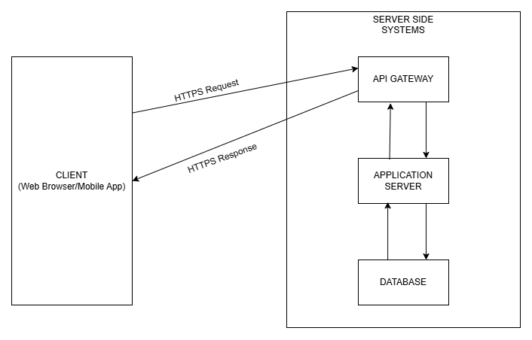

Slide 5
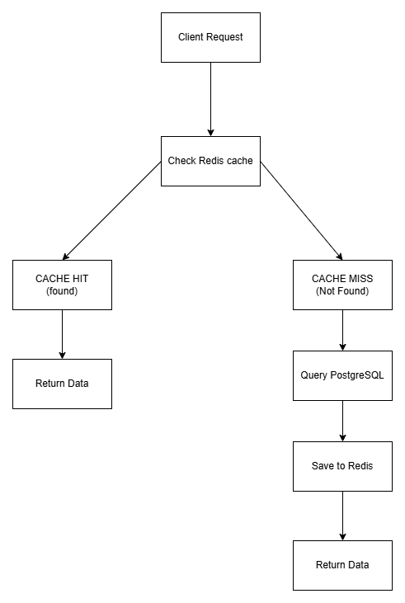

Slide 6
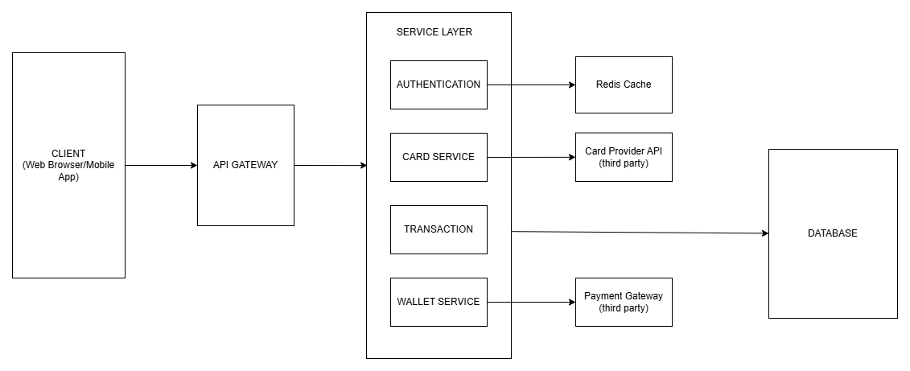

Slide 7
Technology Stack
Language
Java for security, scalability, and performance
Database
PostgreSQL for reliable transactions and flexible data storage
Caching
Redis for high-performance caching and session management

Slide 8
Conclusion

Slide 9
Thank You
Samantha Ngong

